Slide 1

POLICE OVERTIME
Project Extension
Exploring the Nexus of Overtime Expenditure, Staffing Levels and Crime Rates within BDP
TEAM E
Nurassyl Medeu, Jiawei Sun, Truc Duong, Can Wang, Al Mbaye

Slide 2
OVERVIEW & OBJECTIVES
1
BACKGROUND
2
MOTIVATION
3
GOAL
Recent analyses highlighted inefficiencies and potential misconduct.
Examining the relationship between staffing levels and overtime spending is crucial for optimization.
Investigate the correlation between staffing levels within the Boston Police Department (BPD) and overtime expenditures.
Understand if understaffing is a primary factor contributing to excessive overtime pay.
Provide insights into workforce management strategies for the BPD.

Slide 3
Project Extension Progress
PROGRESS
DIVISION OF WORK
DATASETS
- Analyzed the trends in BDP staffing, overtime spending, and crime rates over years
- Utilized historical trends and data projections to predict the total BPD overtime expenditure for the year 2024
- Each team member addressed a section or some questions of the extended project
- BPD Crime Incident Reports from 2016 - 2022
- Worcester/ Cambridge/ Washington Crime Reports

Slide 4

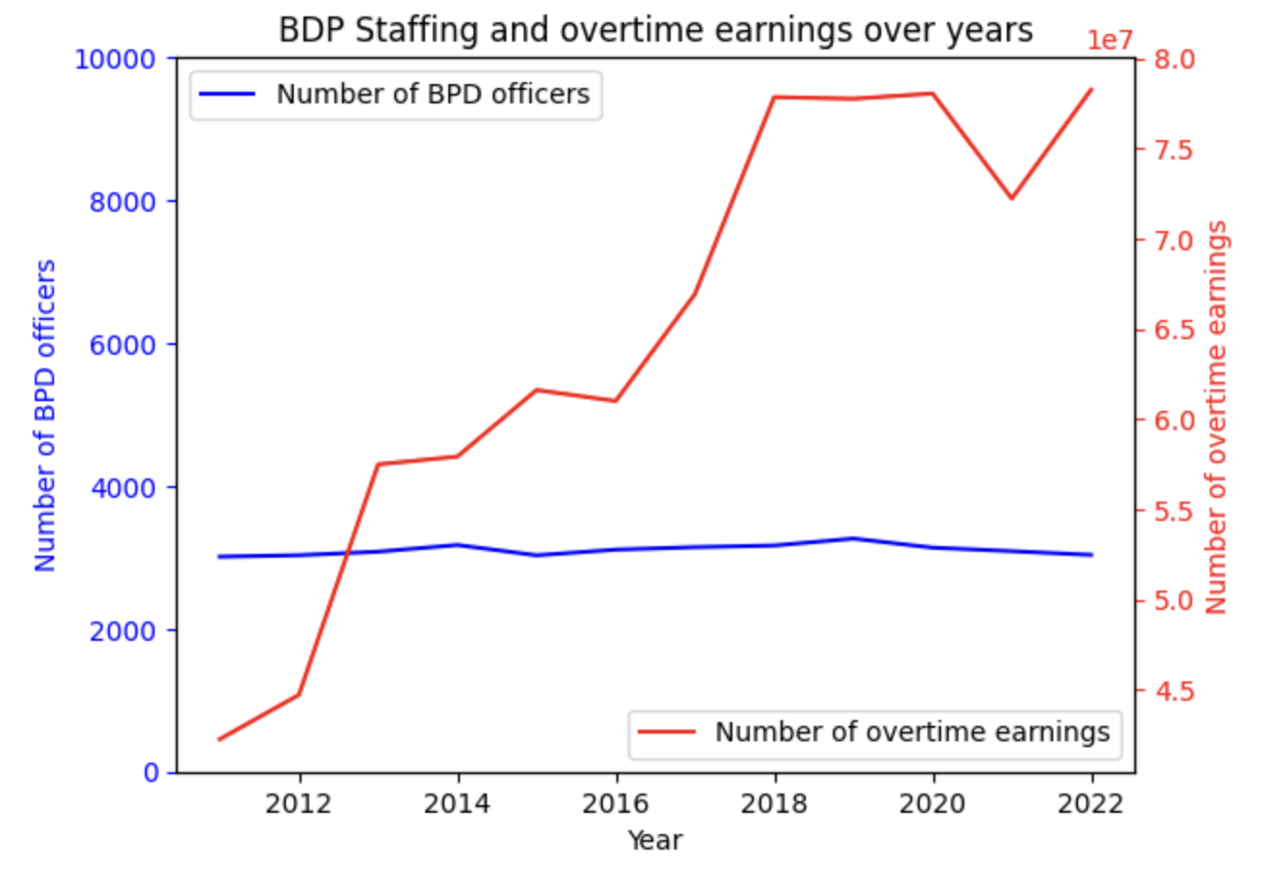

The number of BPD staffing stayed around the same value (about 3000 officers) from year to year.
The amount of overtime earnings grew significantly.
This indicates that each officer had more earnings on overtime. This can signal that BPD was experiencing short-staffing.
Staffing vs Overtime Spending

Slide 5
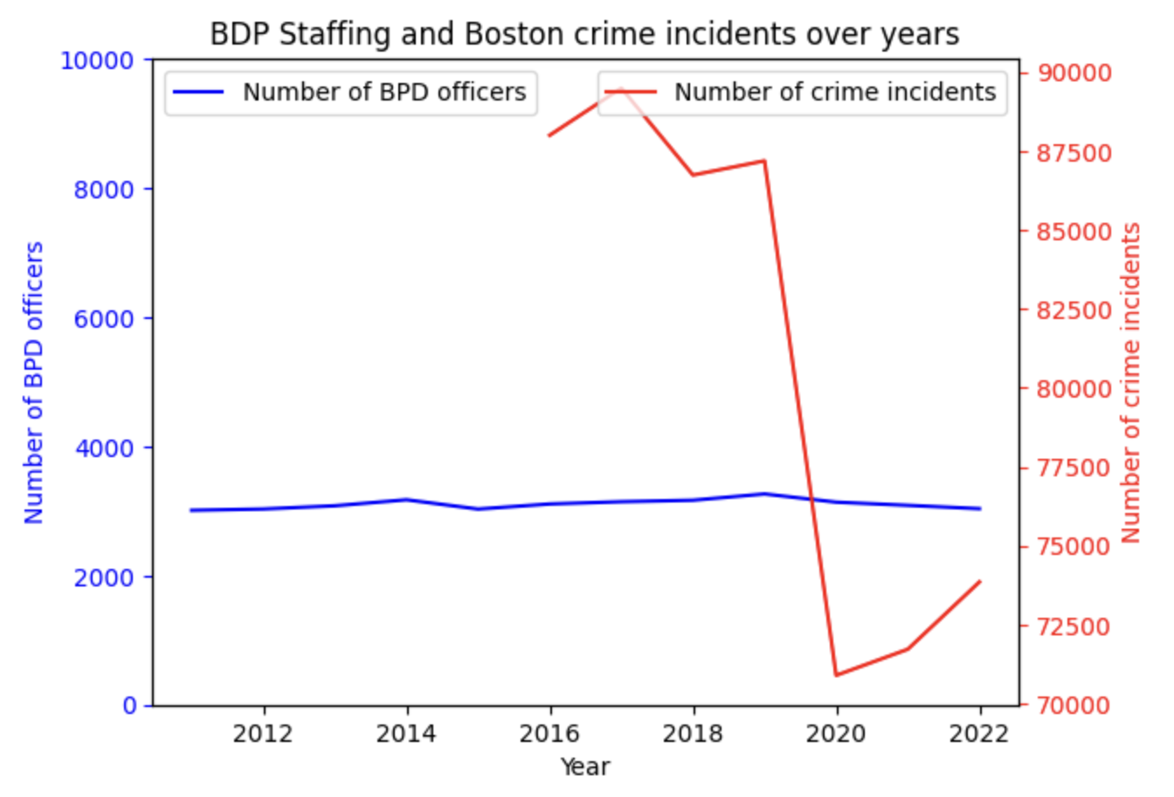

The number of BPD staffing stayed around the same value (about 3000 officers) from year to year.
The number of crime incidents decreased significantly in 2020 (possibly due to Covid-19)
This indicates that the trend of crime incidents had no explicit relation to BPD staffing or overtime expenditures.
Staffing vs Crime Rate

Slide 6

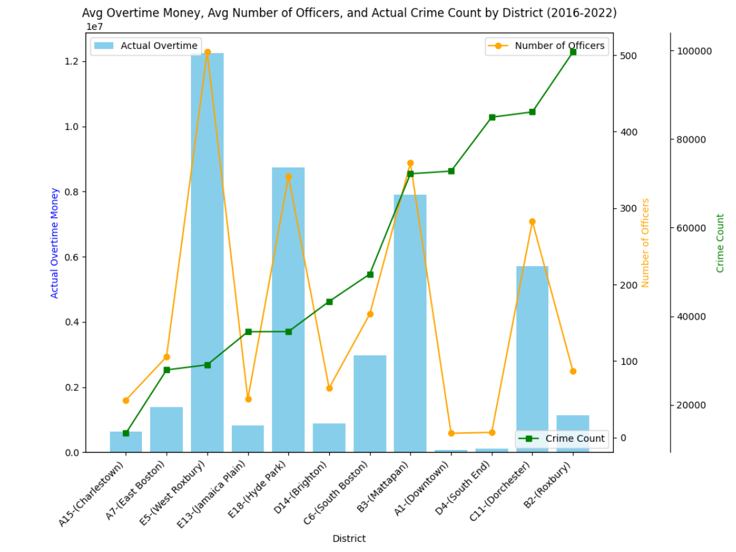
The overtime spending experienced a very similar trend to the number of officers.
There are higher crime rates in districts with fewer number of officers (i.e Roxbury: the number of officers is small and there is a high crime rate).
However, in district with more number of officers, crime rate is still high (i.e: Mattapan).
Again, we don’t see an implicit relationship between crime rates and BPD overtime spending
Staffing vs Crime Rate vs Overtime Spending by Districts

Slide 7

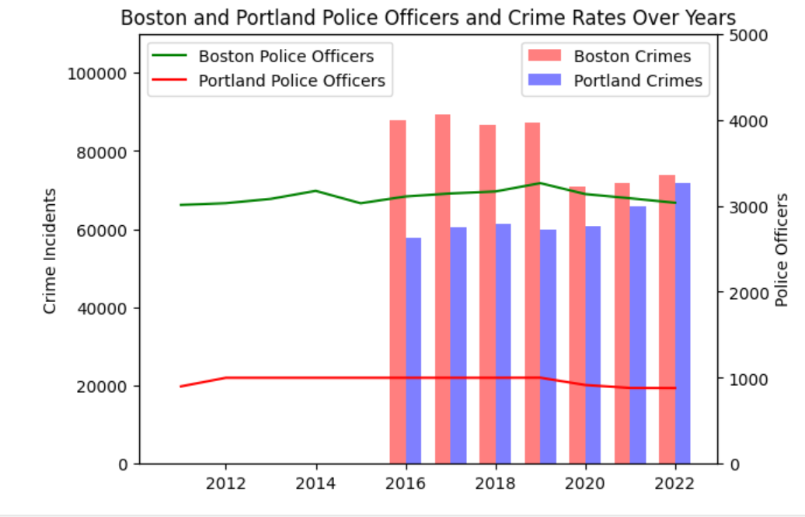
Portland, Oregon was selected due to it being to closest city to Boston in terms of population
While Boston crime rates decreased and Portland crime rates increased, they both had around 70000 crime incidents from 2020 - 2022
However, the number of officers in Boston tripled that in Portland, indicating that Boston staffing problem isn’t as serious
Portland is experiencing a decline and staffing but a rise in crime; a telltale sign of understaffing
Boston’s staffing is remaining relatively stable while crime has decreased overall since 2016, suggesting Boston is adequately staffed
Staffing vs Crime Rate comparison with Portland

Slide 8
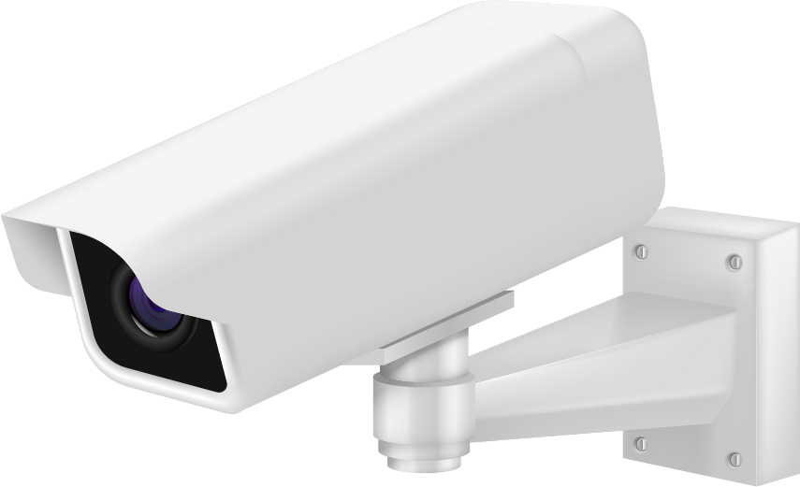
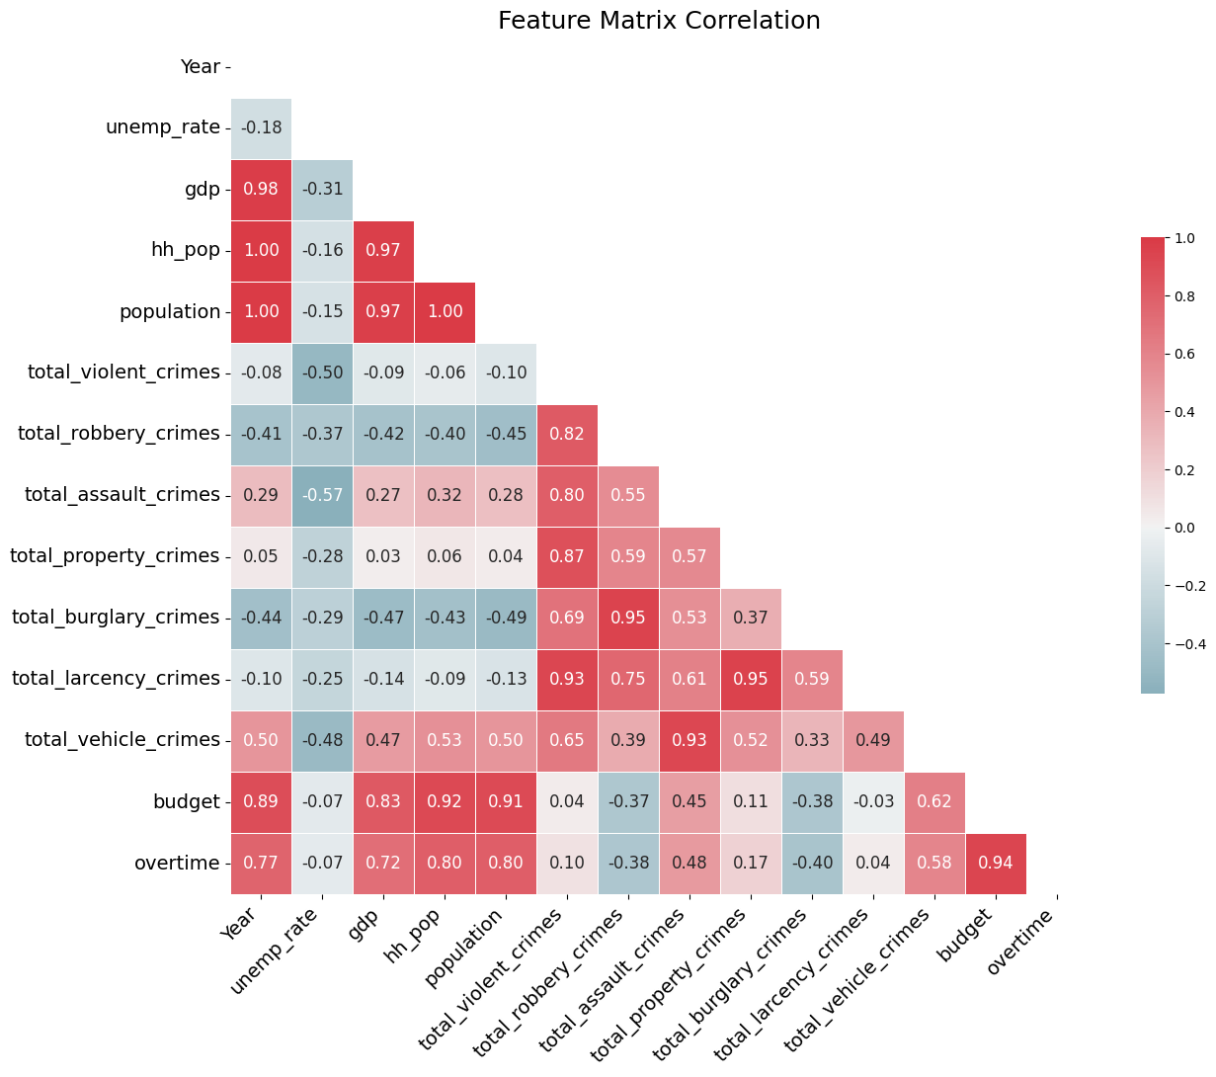
Used data available for 2024 projection
Economic data showed highest correlation with Overtime Earnings
Crimes had smaller correlation, no projection data for 2024
Dateset
FRED Boston GDP 2013-2023
Worldpopulation, Boston Population 2013-2023
Boston.gov economic data
Prediction Model: Feature Selection

Slide 9

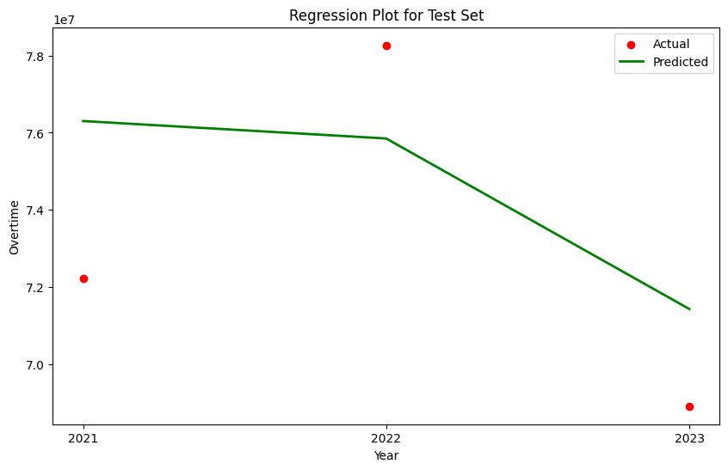
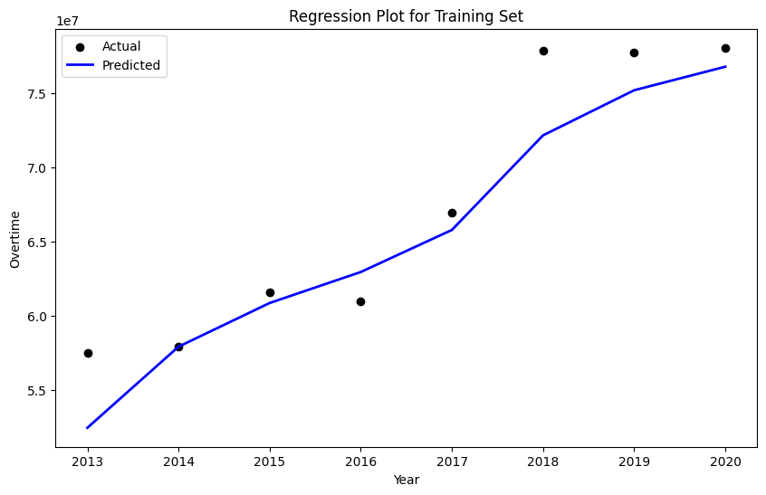
LinearSVR() model was used
Trained on years 2013-2020
Tested on 2021-2023
Testing
Mean Absolute Percentage Error (MAPE) Test: 0.056%
Mean Absolute Percentage Error (MAPE) Train: 0.032%
Prediction Model: Results and Testing
Overtime Earnings Prediction for 2024
$75,564,620.56

Slide 10


Thank you
for listening!
TEAM E

Slide 11

Individual Contribution
Nurassyl Medeu
Initiate project extension ideas
Created a model using historical trends to predict future BPD overtime spending
Jiawei Sun
Analyzed overtime earnings, hours paid, hours worked relation.
Contributed to building the prediction model for future BPD overtime spending
Truc Duong
Contributed to project extension ideas, datasets on crime rates
Analyzed staffing, overtime spending trends changes overtime and by districts
Can Wang
Complete additional base questions.
Analyze the factors that affected overtime payments.
Al Mbaye
Contributed to project extension ideas, datasets on other cities
Analyzed staffing vs crime rates trends, crime incidents category over years and by districts

